Slide 1
Microsoft Azure: SQL Migration in Azure

Slide 2
Deep dive on Azure SQL Migrations
Abdul Rasheed Feroz Khan
Microsoft MVP – Azure
@TechFero

Slide 3
Session objectives
Learn phases in migration journey
Familiar with Microsoft Data migration tools
Deep dive into live database migrations
Azure SQL Synapse

Slide 4









Database migration process overview
Post-migration
Optimize
Based on the tests you performed, address any performance issues, and then retest to confirm the performance improvements
Pre-migration
Migration
Discover
Assess
Convert
Migrate schema, data & objects
Data sync
Cutover
Remediate applications
Iteratively make any necessary changes to your applications
Inventory database assets, and application stack discovery
Assess workloads and fix recommendations
Convert the source schema to work in the target environment. This is only relevant for heterogeneous migrations.
Migrate the source schema, and then migrate the source data to the target
Sync your target schema and data with the source. This is only relevant for minimal-downtime migrations
Cut over from the source to the target environment. This is only relevant for minimal-downtime migrations
Run functional & performance tests
Iteratively run functional and performance tests
Notes:
Accelerate your database migration
Reduce the complexity of your cloud migration by using a single comprehensive service instead of multiple tools. Azure Database Migration Service is designed as a seamless, end-to-end solution for moving on-premises SQL Server databases to the cloud. Use the Database Migration Guide for recommendations, step-by-step guidance and expert tips on your specific database migration.

Slide 5



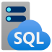

ASP.NET Application Migration to Azure
On-premises
Azure
VMware
LOB App
App Service
Migration Assistant
LOB App
App layer
Azure App Service
App layer
Windows Server
Data layer
Azure SQL Database Managed Instance
Data layer
SQL Server
Azure Database Migration Service

Slide 6





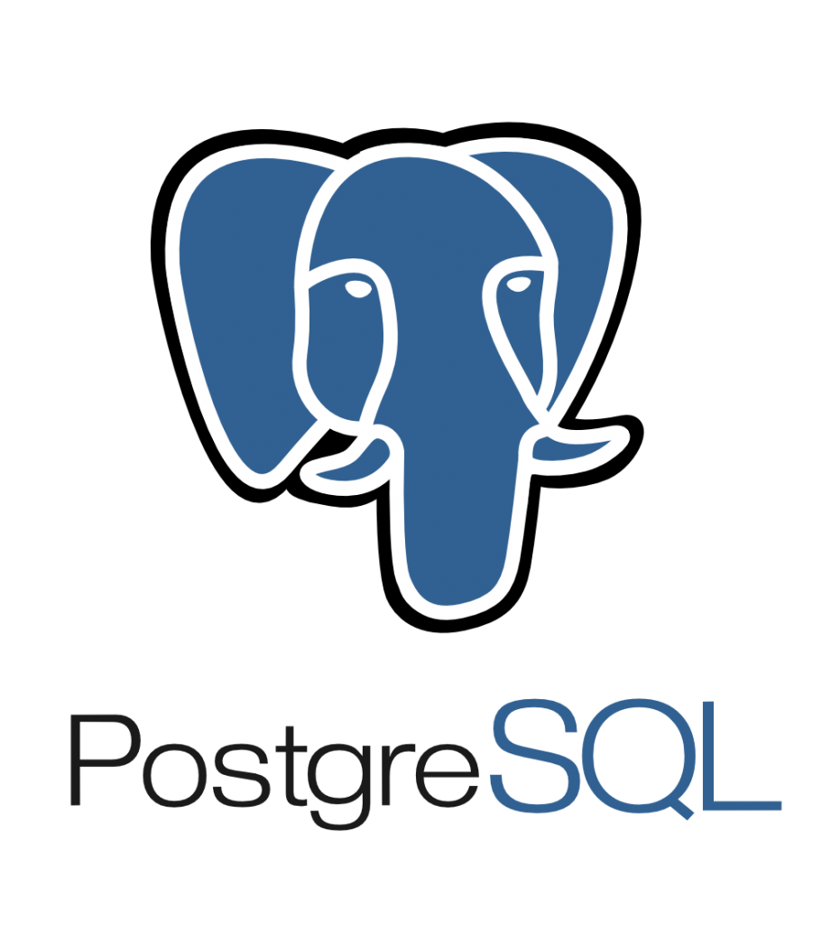





Tools and services for your migration journey
On-premises
Microsoft Azure
Assessment
Azure Migrate, SSMA, DMA, DEA
Migration
Azure Database Migration Service

Slide 7
Demo
Migrating SQL Server to Azure SQL Database

Slide 8
Use case
Contoso wants to migrate an on-premises SQL Server database to Azure SQL Database. As a Data Analyst you have to migrate an on-premise SQL Server to Azure SQL Database by using Azure Database Assistance.

Slide 9
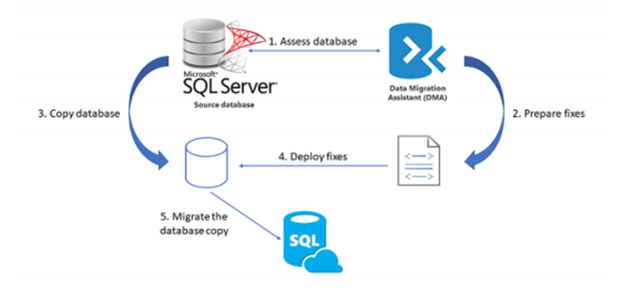
Solution Architecture

Slide 10




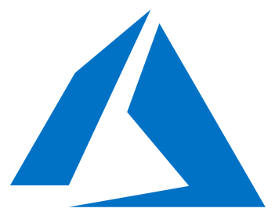




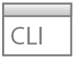
What is DMS hybrid mode?
Customer subscription
On-premises
Azure Portal
Database endpoint
Data movement
PowerShell
Cloud DMS control communication
443 (SSL) outbound only
CLI commands
Azure Database Migration Service
DMS hybrid worker running on-premises

Slide 11

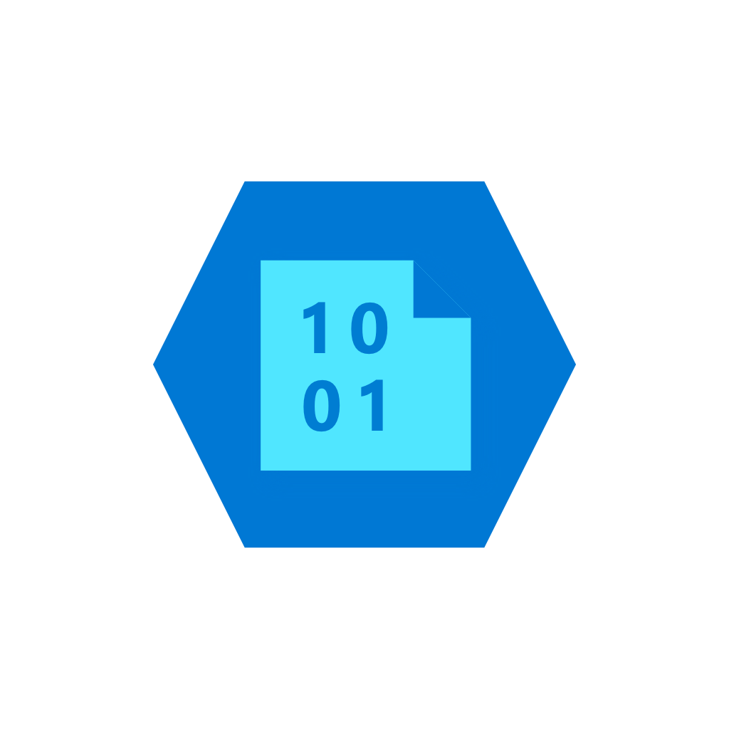


Online migration with backup and restore technology SQL Server to Azure SQL Database Managed Instance example
Provide existing backups in network share
DMS upload backup files to Azure storage
DMS initiate the migration to Managed Instance
Full backup restored and Transaction log backups continuously applied until cutover
Stop incoming traffic to source databases, provide Tail-Log backup, initiate cutover in DMS and change the application connection strings
Virtual Network (VNET)
1
2
Subnet used for MI
3
Azure Blob Storage
Cloud network
4
4
2
SQL DB Managed Instance
3
Subnet used for DMS
Legend
Full Database backup files
Transaction log backup files
Site to site connectivity (VPN or ExpressRoute)
SMB Network Share
1
On-premises

Slide 12
Azure Migration Program
Available to all Azure customers, scaled through specialized migration partners
Best practice guidance
Offers and incentives
Technical skill building
Infrastructure and data foundations
Migration planning and execution
Digital resources
Free tools
(Azure Migrate)
Azure trainers
Azure engineering (FastTrack)
Specialized partners
Reduce cost and risk | Accelerate migration velocity | Deliver customer success
Learn more | Azure.com/AMP

Slide 13
Recap: Azure Migrate – Integrated Experience
Available today
Recent updates
Database assessments
SQL Server database assessments
Target readiness and size assessments
SSIS package assessmnets
Application data layer assessments
Oracle/ Sybase/ DB2 assessments and schema conversion
Assessment for SQL databases using DMA in Azure Migrate
Migrations
Windows and SQL logins migrations
SSIS package migrations
Assessments^{NEW}
.NET application assessments
SQL Server 2019 support in DMA
Load and save assessments in DMA
Azure Database Migration Service
Migrations ^{NEW}
Azure DMS Hybrid mode
PostgreSQL hyper-scale migration

Slide 14
Network Topologies for Database Migrations on Azure
Azure SQL Database Managed Instance configured for Hybrid workloads
Notes:
These are the various network topologies that Azure Database Migration Service can work with to provide a comprehensive migration experience from on-premises SQL Servers to Azure SQL Database Managed Instance.
Use this topology if your Azure SQL Database Managed Instance is connected to your on-premises network. This approach provides the most simplified network routing and yields maximum data throughput during the migration.
Requirements
In this scenario, the Azure SQL Database managed instance and the Azure Database Migration Service instance are created in the same Azure VNet, but they use different subnets.
The VNet used in this scenario is also connected to the on-premises network by using either ExpressRoute or VPN.

Slide 15
Network Topologies for Database Migrations on Azure
Azure SQL Database Managed Instance isolated from the on-premises network
Notes:
Use this network topology if your environment requires one or more of the following scenarios:
The Azure SQL Database managed instance is isolated from on-premises connectivity, but your Azure Database Migration Service instance is connected to the on-premises network.
If Role Based Access Control (RBAC) policies are in place and you need to limit the users to accessing the same subscription that is hosting the Azure SQL Database managed instance.
The VNets used for the Azure SQL Database Managed Instance and Azure Database Migration Service are in different subscriptions.
Requirements
The VNet that Azure Database Migration Service uses for this scenario must also be connected to the on-premises network by using either (https://docs.microsoft.com/azure/expressroute/expressroute-introduction) or VPN.
Set up VNet network peering between the VNet used for Azure SQL Database managed instance and Azure Database Migration Service.

Slide 16
Network Topologies for Database Migrations on Azure
Cloud-to-cloud migrations: shared VNet
Notes:
Use this topology if the source SQL Server is hosted in an Azure VM and shares the same VNET with Azure SQL Database managed instance and Azure Database Migration Service.
Requirements
No additional requirements.

Slide 17
Network Topologies for Database Migrations on Azure
Cloud to cloud migrations: isolated VNet
Notes:
Use this network topology if your environment requires one or more of the following scenarios:
The Azure SQL Database managed instance is provisioned in an isolated VNet.
If Role Based Access Control (RBAC) policies are in place and you need to limit the users to accessing the same subscription that is hosting the Azure SQL Database managed instance.
The VNets used for Azure SQL Database Managed Instance and Azure Database Migration Service are in different subscriptions.
Requirements
Set up VNet network peering between the VNet used for Azure SQL Database managed instance and Azure Database Migration Service.

Slide 18
Inbound Security rules
NAME | PORT | PROTOCOL | SOURCE | DESTINATION | ACTION
DMS_subnet | Any | Any | DMS SUBNET | Any | Allow

Slide 19
Outbound security rules
NAME | PORT | PROTOCOL | SOURCE | DESTINATION | ACTION
management | 443,9354 | TCP | Any | Any | Allow
Notes:
Reason for this rule:
Management plane communication through service bus and Azure blob storage. (If Microsoft peering is enabled, you may not need this rule.)

Slide 20
Outbound security rules
NAME | PORT | PROTOCOL | SOURCE | DESTINATION | ACTION
Diagnostics | 12000 | TCP | Any | Any | Allow
Notes:
Reason for this rule:
Management plane communication through service bus and Azure blob storage. (If Microsoft peering is enabled, you may not need this rule.)

Slide 21
Outbound security rules
NAME | PORT | PROTOCOL | SOURCE | DESTINATION | ACTION
SQL Source server | 1433 (or TCP IP port that SQL Server is listening to) | TCP | Any | On-premises address space | Allow
Notes:
Reason for this rule:
SQL Server source connectivity from DMS (If you have site-to-site connectivity, you may not need this rule.)

Slide 22
Outbound security rules
NAME | PORT | PROTOCOL | SOURCE | DESTINATION | ACTION
SQL Server named instance | 1434 | UDP | Any | On-premises address space | Allow
Notes:
Reason for this rule:
SQL Server named instance source connectivity from DMS (If you have site-to-site connectivity, you may not need this rule.).)

Slide 23
Outbound security rules
NAME | PORT | PROTOCOL | SOURCE | DESTINATION | ACTION
SMB share | 445 | TCP | Any | On-premises address space | Allow
Notes:
Reason for this rule:
SMB network share for DMS to store database backup files for migrations to Azure SQL Database MI and SQL Servers on Azure VM (If you have site-to-site connectivity, you may not need this rule).

Slide 24
Outbound security rules
NAME | PORT | PROTOCOL | SOURCE | DESTINATION | ACTION
DMS_subnet | Any | Any | Any | DMS_subnet | Allow

Slide 25
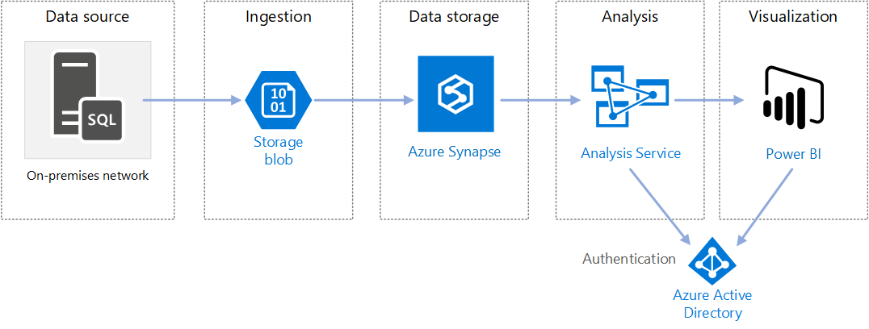
Azure SQL Synapse
Enterprise BI in Azure with Azure Synapse Analytics

Slide 26
Key Migration references
Migration Guide - https://datamigration.microsoft.com​
Azure Database Migration Service – https://aka.ms/AzureDms​
Data Migration Assistant - https://aka.ms/get-dma​
SQL Server Migration Assistant - https://aka.ms/get-ssma​
Database Experimentation Assistant - https://aka.ms/dea-tool​

Slide 27
Your path to the cloud Ensure organizational readiness with Azure migration sessions at Ignite
Visit the Microsoft Showcase | Get started with Azure
Accelerate your cloud journey: Cloud Adoption Framework for Azure
Simplify your cloud migration: Azure Migration Program
Build and deploy with confidence: FastTrack for Azure
Optimize cloud costs: Azure Free Account, Azure Cost Management + Billing

Slide 28

Please evaluate this session Your feedback is important to us!
Please evaluate this session through the website.
Go to the website: https://hackbox.in

